Slide 1
Computer Science
Algorithms Complexity and Data Structures

Slide 2
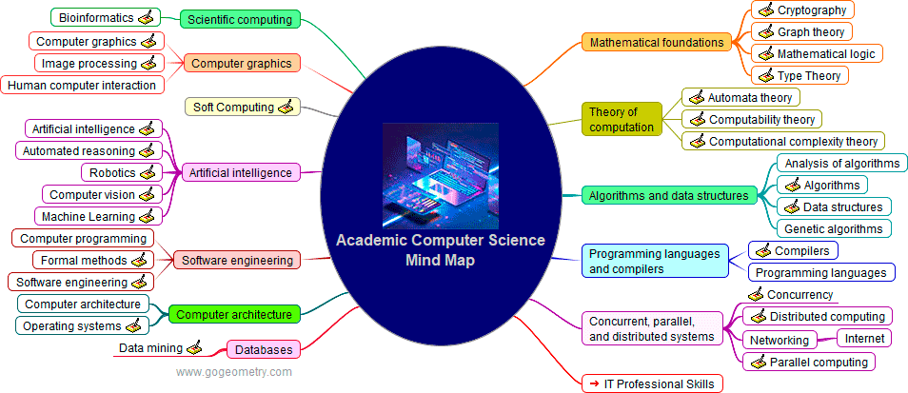
Computer Science
is the study of computation, information, and automation

Slide 3
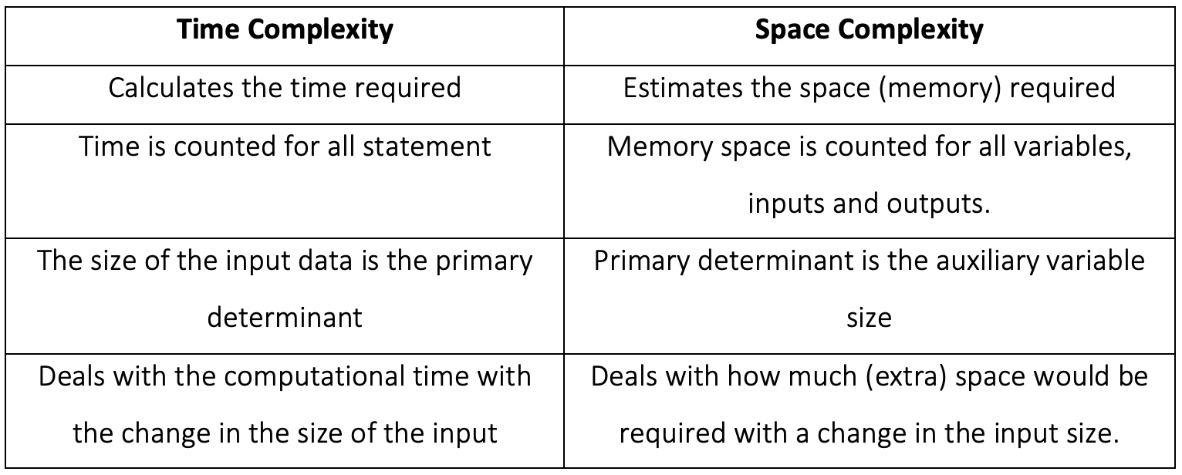
Computational Complexity

Slide 4
Exact vs Asymptotic Analysis
exact estimation of execution time
each base operation has different execution time
hard to compute
dependence of the number of operations on input data
assigning an algorithm to a complexity class
base operations are “equal”
easy to estimate

Slide 5
S.No. | Big O | Big Omega (Ω) | Big Theta (Θ)
1. | It is like (<=) rate of growth of an algorithm is less than or equal to a specific value. | It is like (>=) rate of growth is greater than or equal to a specified value. | It is like (==) meaning the rate of growth is equal to a specified value.
2. | The upper bound of algorithm is represented by Big O notation. Only the above function is bounded by Big O. Asymptotic upper bound is given by Big O notation. | The algorithm’s lower bound is represented by Omega notation. The asymptotic lower bound is given by Omega notation. | The bounding of function from above and below is represented by theta notation. The exact asymptotic behavior is done by this theta notation.
3. | Big O – Upper Bound | Big Omega (Ω) – Lower Bound | Big Theta (Θ) – Tight Bound
4. | It is define as upper bound and upper bound on an algorithm is the most amount of time required ( the worst case performance). | It is define as lower bound and lower bound on an algorithm is the least amount of time required ( the most efficient way possible, in other words best case). | It is define as tightest bound and tightest bound is the best of all the worst case times that the algorithm can take.
5. | Mathematically: Big Oh is 0 <= f(n) <= Cg(n) for all n >= n0 | Mathematically: Big Omega is 0 <= Cg(n) <= f(n) for all n >= n0 | Mathematically – Big Theta is 0 <= C2g(n) <= f(n) <= C1g(n) for n >= n0
Complexity Notations

Slide 6
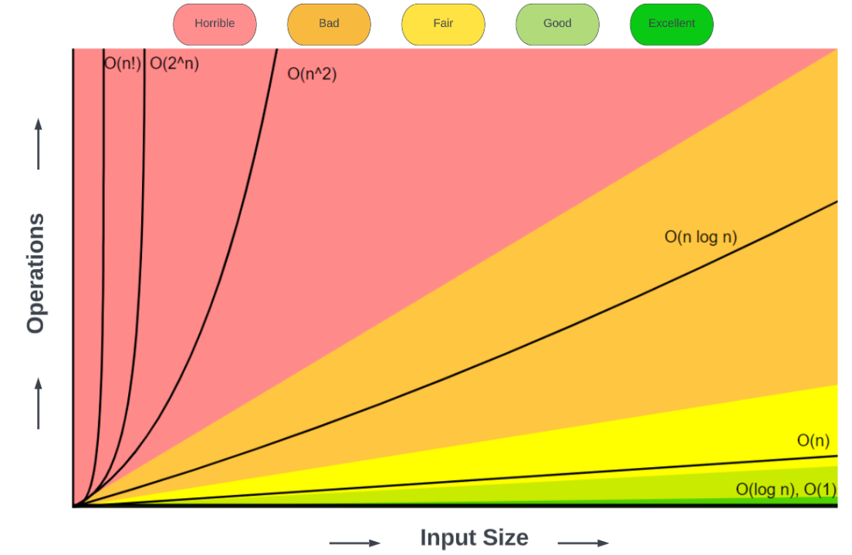
Time Complexity

Slide 7
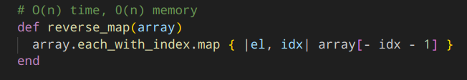
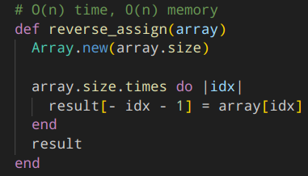
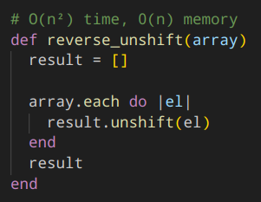
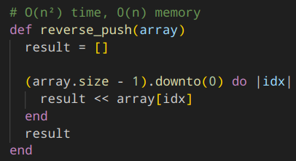
Example
Без использования стандартных функций написать функцию reverse, которая принимает массив и возвращает массив в обратном порядке. Исходный массив мутировать нельзя.

Slide 8
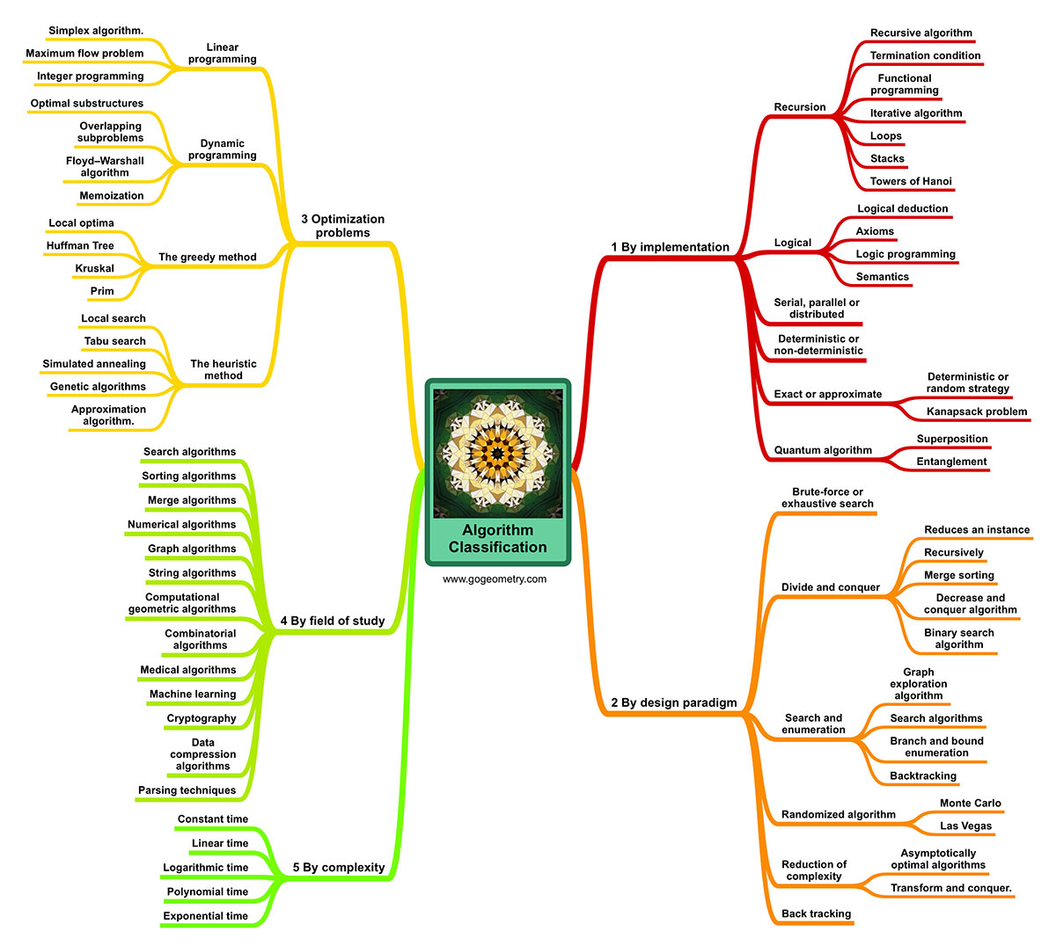
Algorithms
By execution:
Linear
Branching
Cyclic
Recursive
By result:
Deterministic
Randomized
Exact
Heuristic

Slide 9
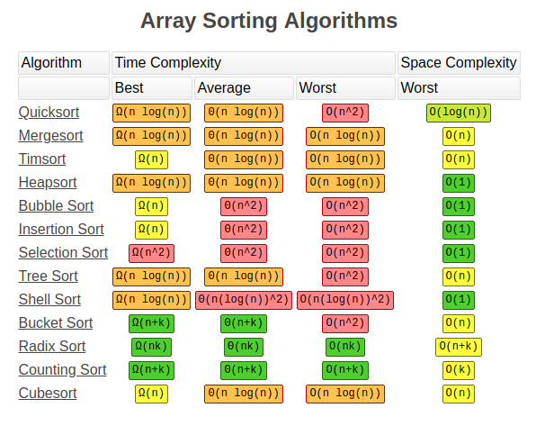
Sorting Algorithms
Puts elements of a list into an order
Stable vs Unstable

Slide 10
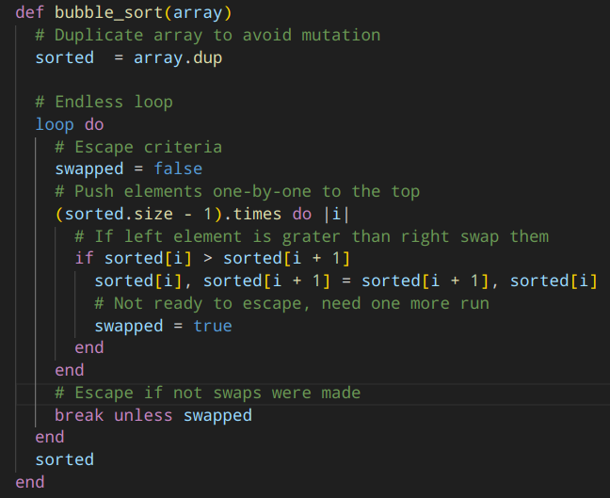
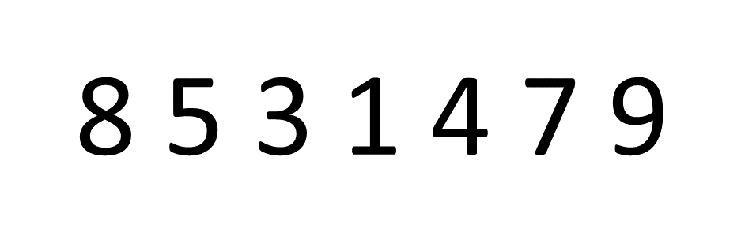
Bubble Sort

Slide 11
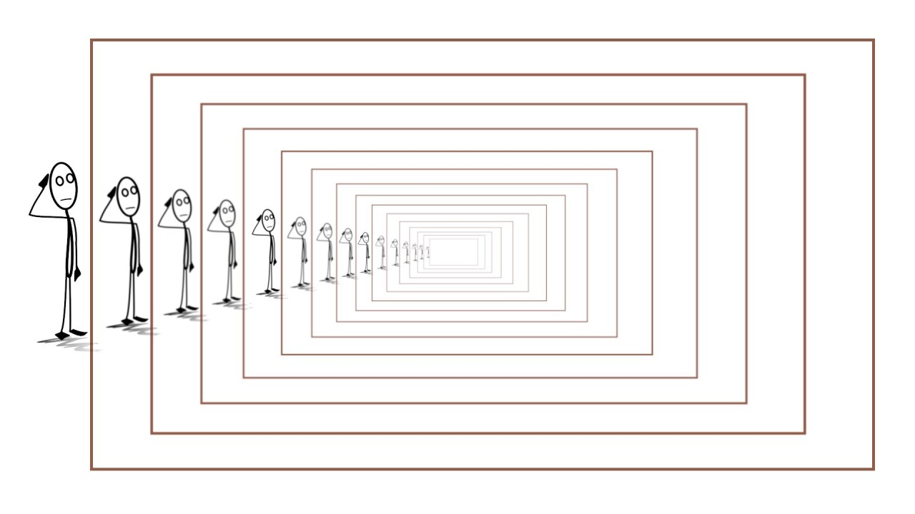
Recursive Algorithms
Function calls itself
Solve smaller subproblems of the original problems
Can lead to stack overflow

Slide 12
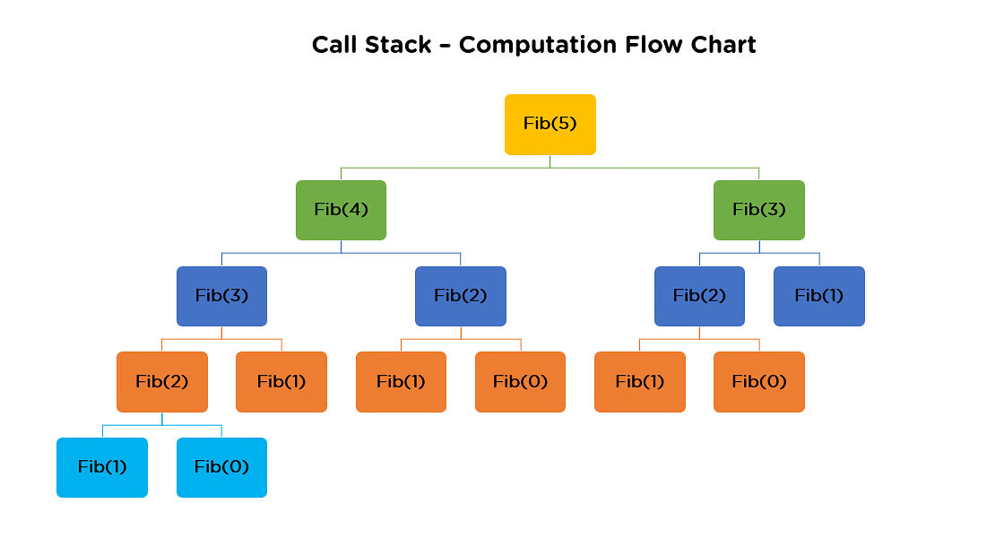
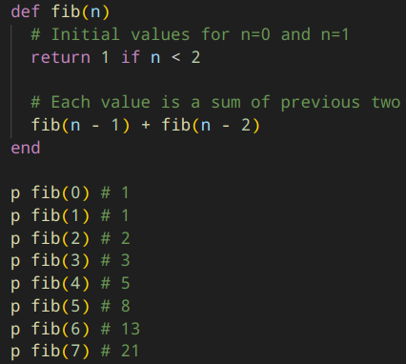
Fibonacci Sequence

Slide 13
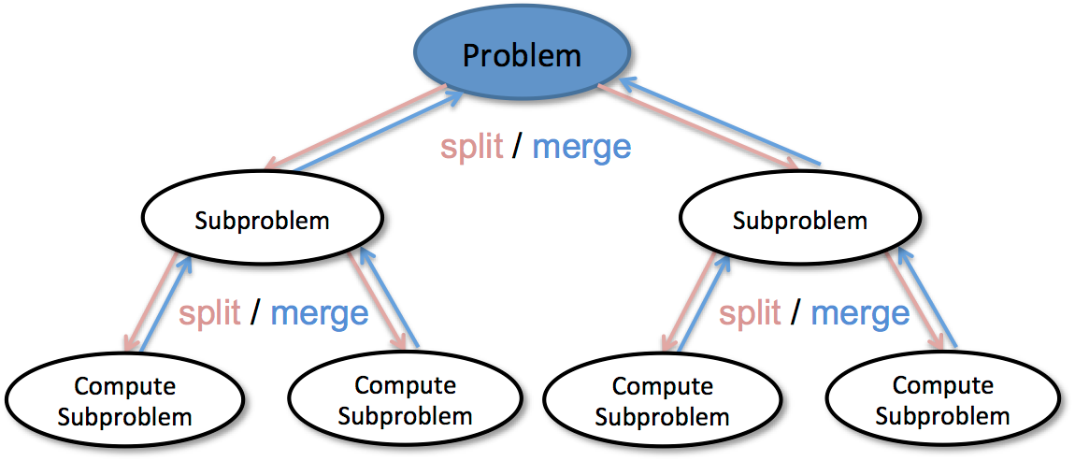
Divide-and-conquer Algorithms

Slide 14
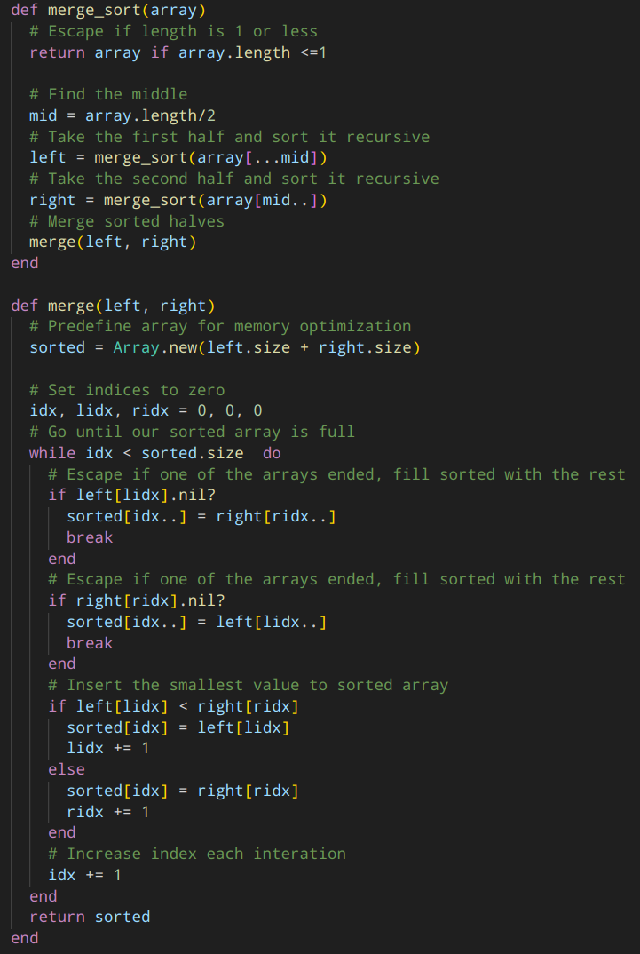
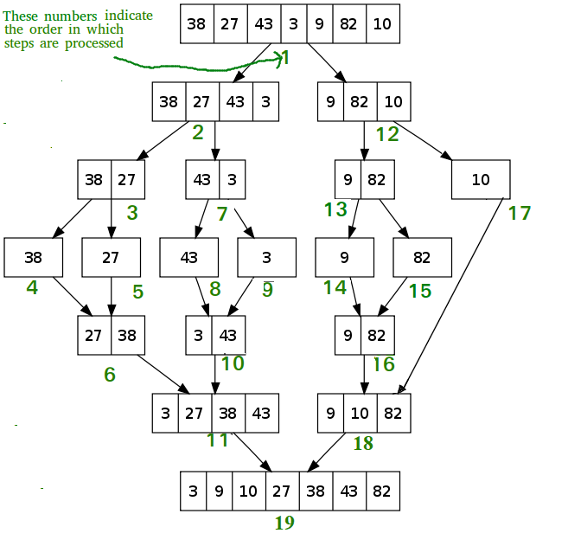
Merge Sort

Slide 15
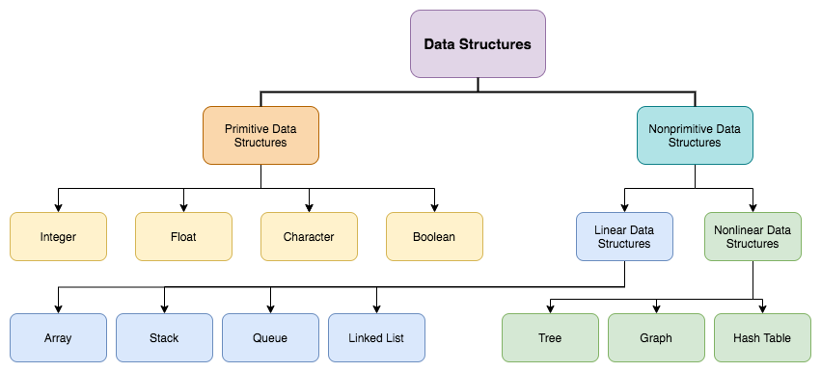
Data Structures
Data storage and data access
Relationships among data
Functions or operations that can be applied to the data

Slide 16
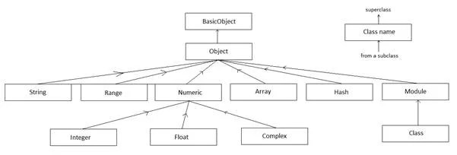
Data Structures in Ruby
Array
Hash
Set
Implement Enumerable
Data can be written and read

Slide 17
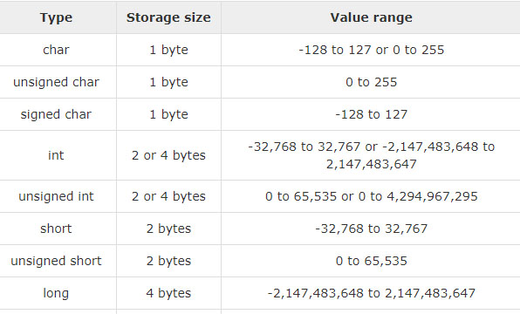
Data Storage

Slide 18
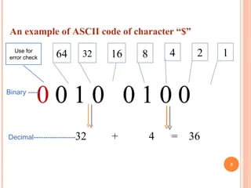
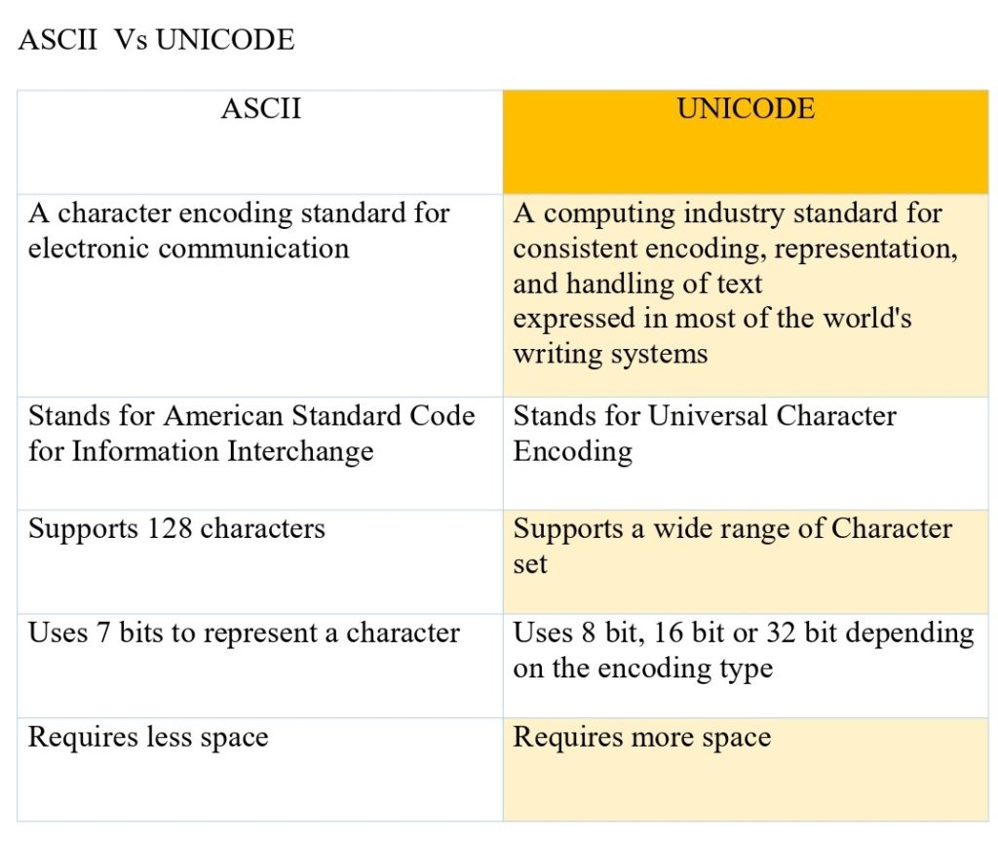
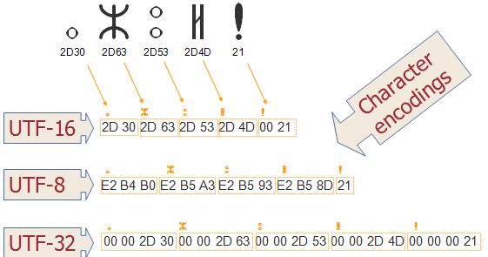
Character Encoding

Slide 19
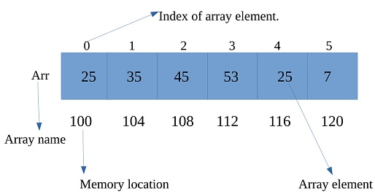
(Dynamic) Array
Collection of values
Ordered
Represented as a pointer to the beginning, size and type
Dynamically resized when needed
Index | Mutation (beginning) | Mutation (middle) | Mutation (end)
O(1) | O(n) | O(n) | O(1) amortized

Slide 20
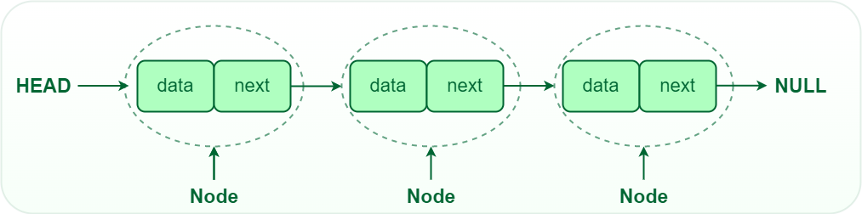
Linked List
Collection of values
Ordered
Represented as a node with a link to the next element
Not bound to size
Index | Mutation (beginning) | Mutation (middle) | Mutation (end)
O(n) | O(1) | O(n) - unknown O(1) - known | O(n) - unknown O(1) - known

Slide 21
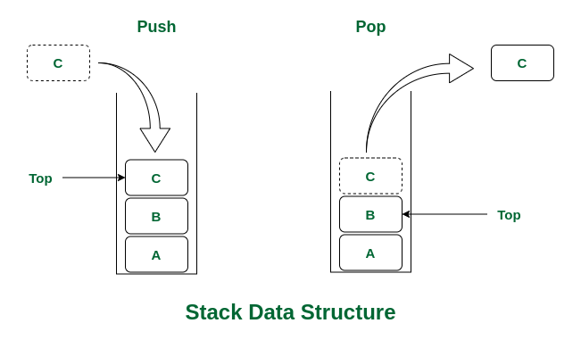
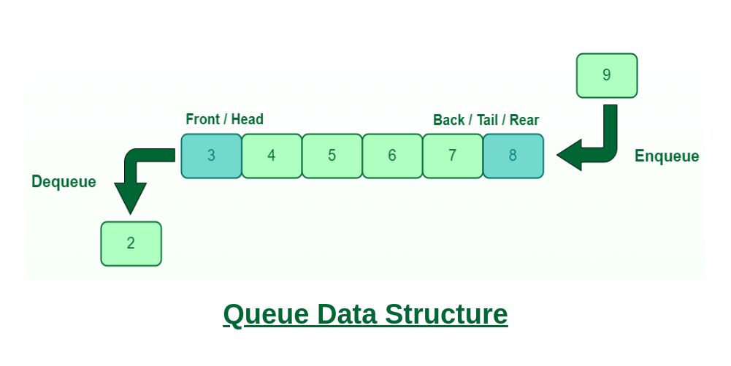
Stack and Queue

Slide 22
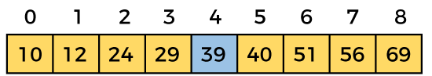
Search Algorithms
Find min/max value
Find index/node with value
Find the nearest value

Slide 23
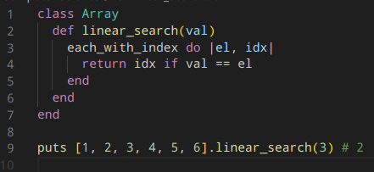
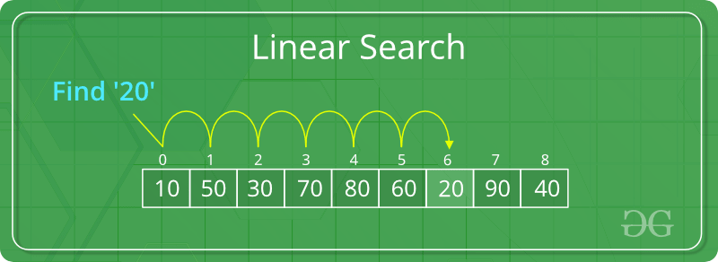
Linear Search
Can be applied to any data structures
Complexity O(n)

Slide 24
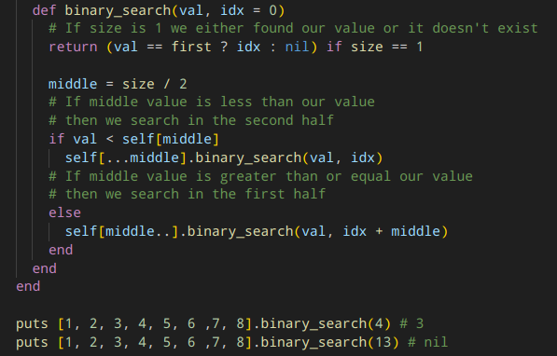
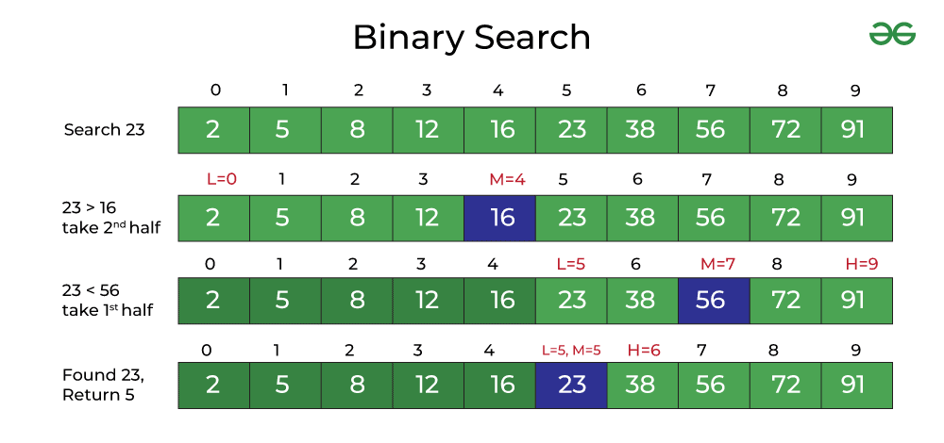
Binary Search
Can be applied only to sorted structures
Complexity O(log n)

Slide 25
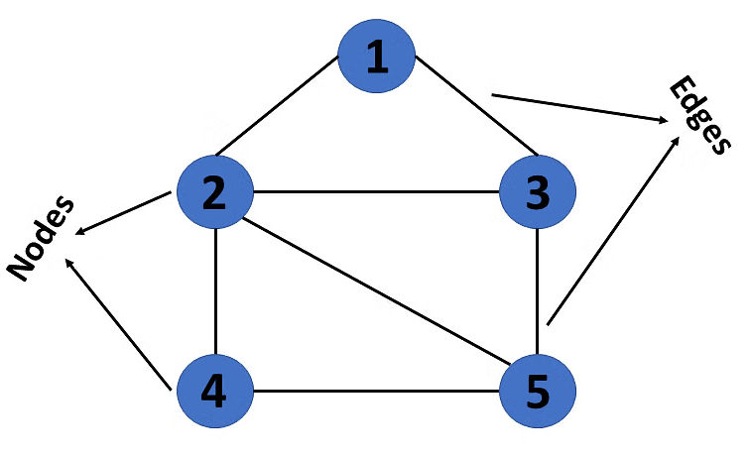
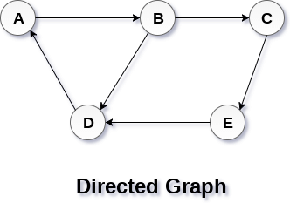
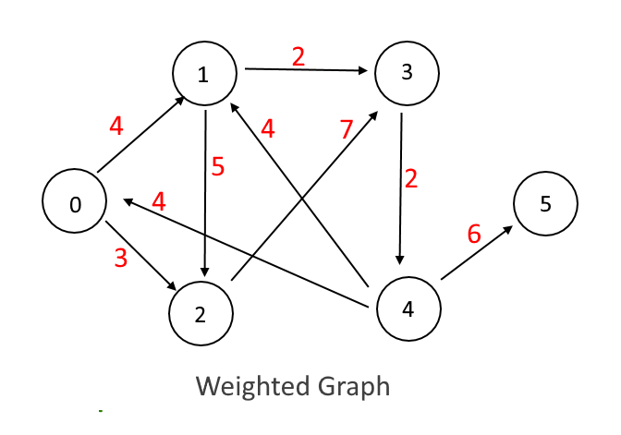
Graph
Nonlinear
Collection of vertices (nodes) and edges
Represented as a pointer to the root node
Graph
Directed Graph
Directed Weighted Graph

Slide 26
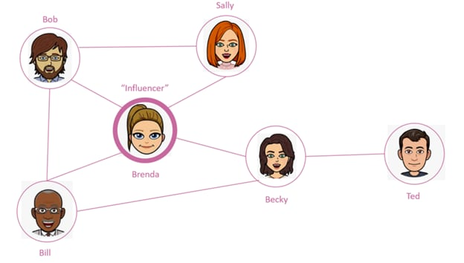
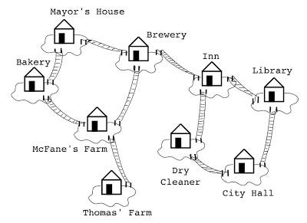
Graph
Social Network
Set of locations with transitions (railroad, airports)

Slide 27
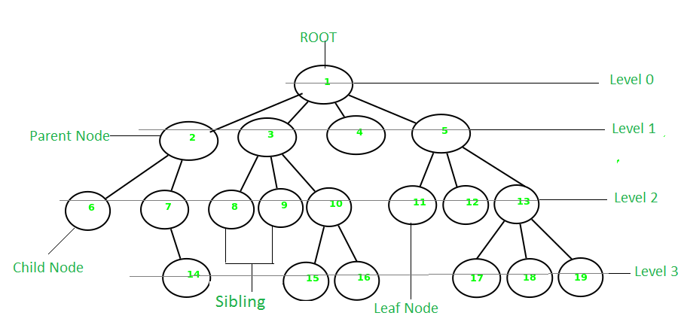
Tree
Graph without cycles
Collection of vertices (nodes) and edges
Always has root and leaves
Has levels (generations) depending on a root selection

Slide 28
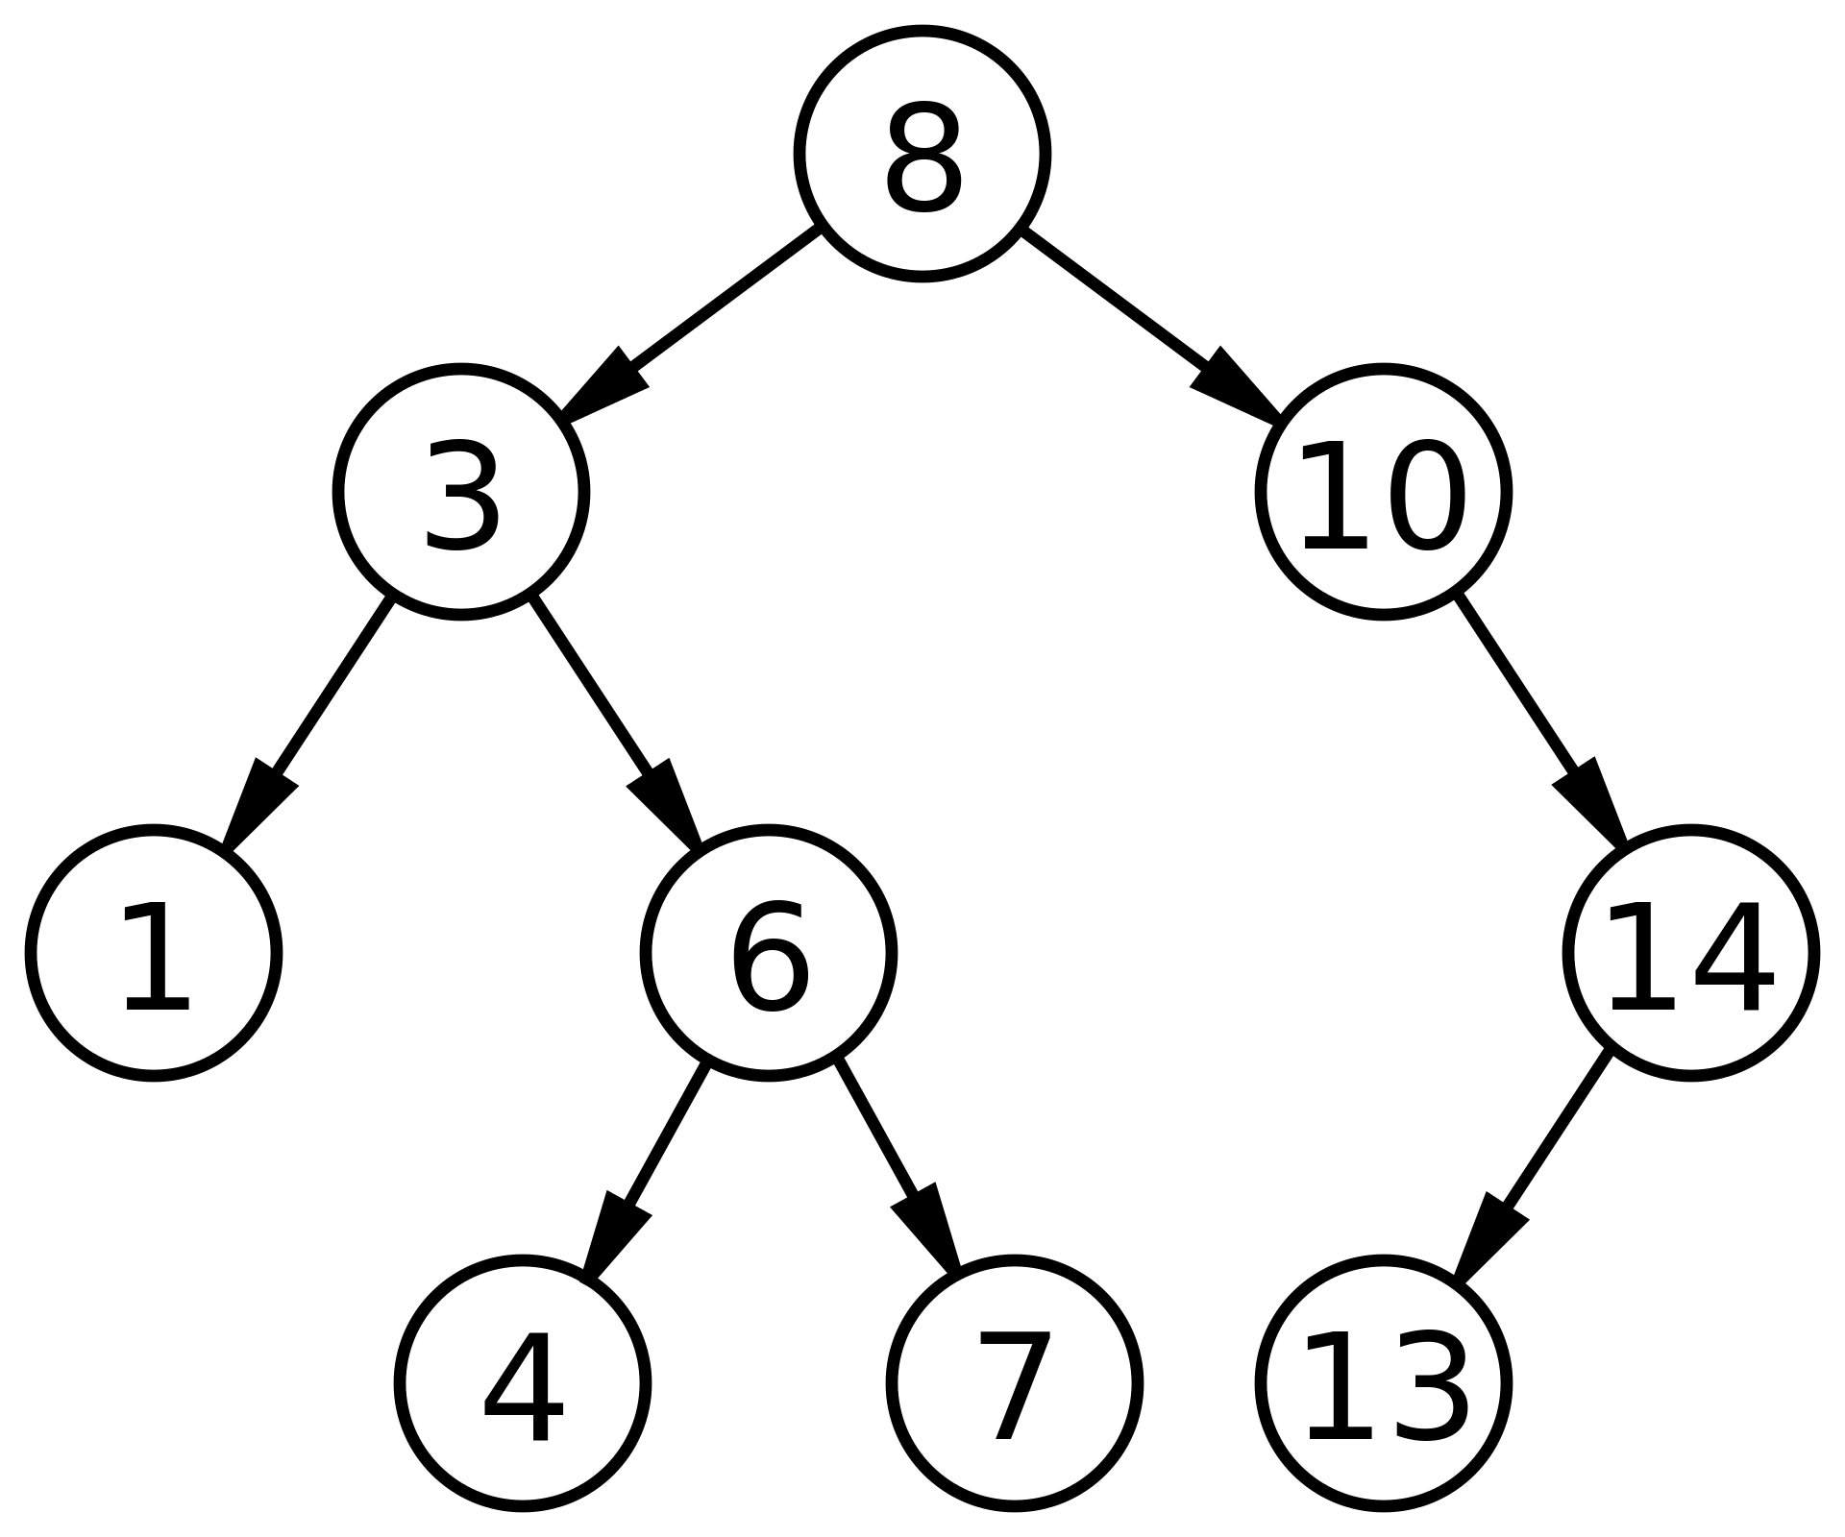
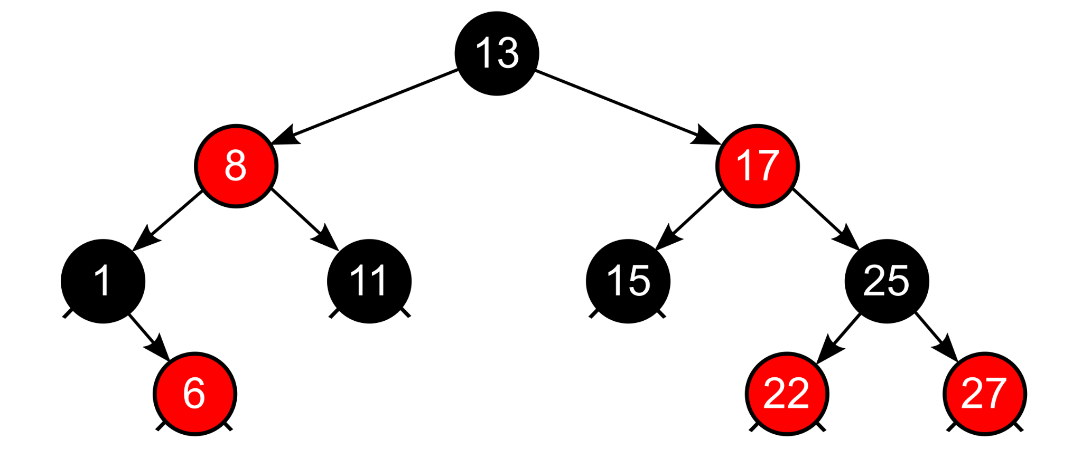
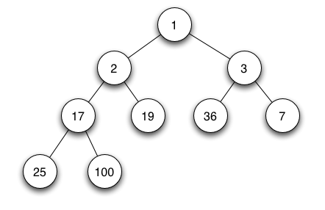
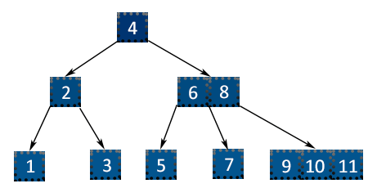
Tree
Binary
Binary Heap
Binary Search Tree
Self-balancing
Red–Black Tree
B-tree
Red-Black Tree
Binary Search Tree
Binary Heap
Search | Insertion | Deletion
O(log n) | O(log n) | O(log n)
B-tree

Slide 29
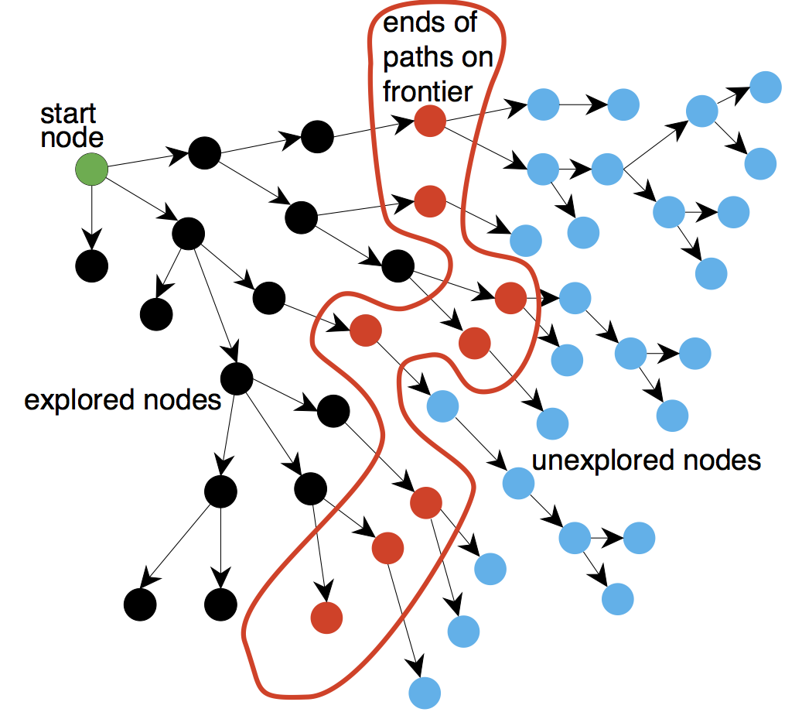
Graph Search
Done by visiting each vertex
Can be done depth-first or breadth-first
Can be implemented recurrently or using queue/stack

Slide 30
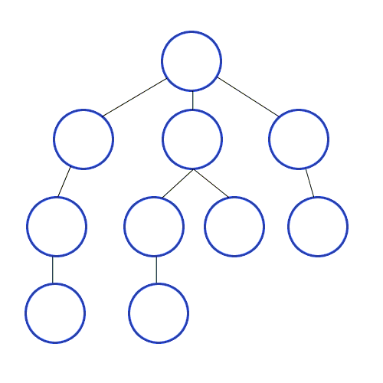
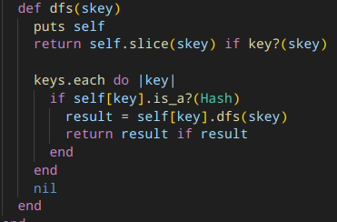
Depth-First Search

Slide 31
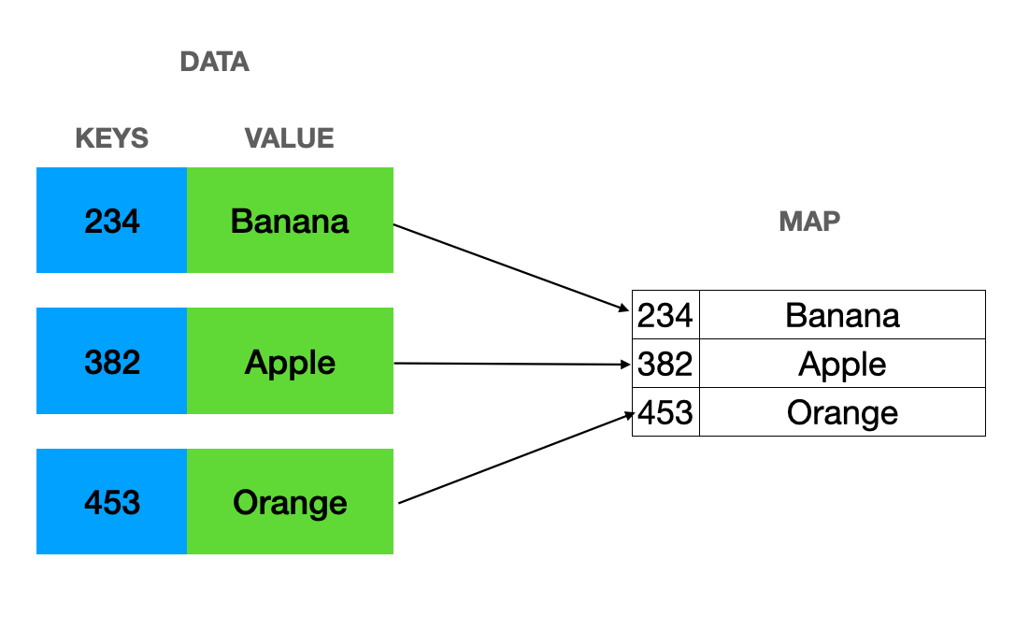
Map or Associative Array or Dictionary
Nonlinear
Collection of key-value pairs
Implemented as a Hash Table or as a Search Tree
Search | Insertion | Deletion
O(log n) | O(log n) | O(log n)

Slide 32
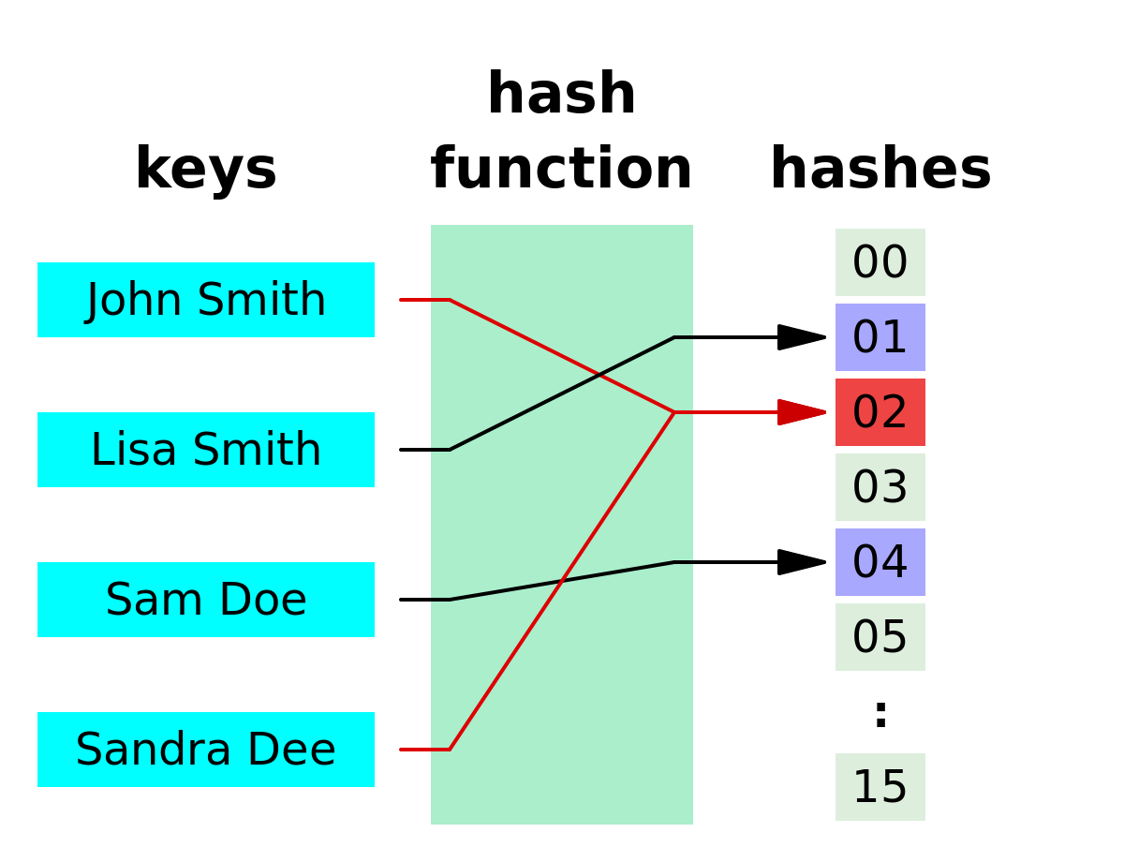
Hash Function
Transforms input to hash value of fixed length
Resulting values are uniformly distributed over the keyspace
Should be very fast to compute
Should minimize duplication of output values (collisions)

Slide 33
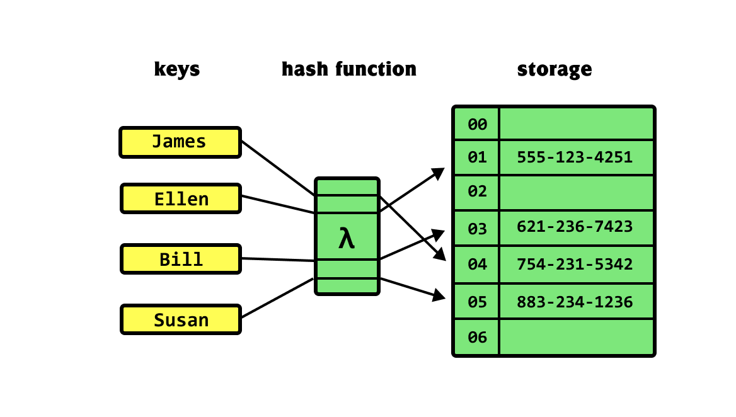
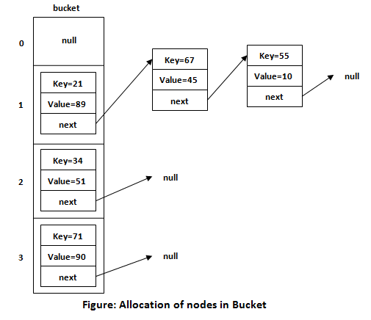
Hash Map
Nonlinear
Collection of key-value pairs
Unordered
Stored as an array
Search | Insertion | Deletion
O(1) | O(1) | O(1)

Slide 34
Application in QA
Each test case is an algorithm
Performance testing
Autotests memory and time optimization

Slide 35

Thank you for your attention!

